Slide 1


UNIT 2: Time for action
A new pupil

Slide 2

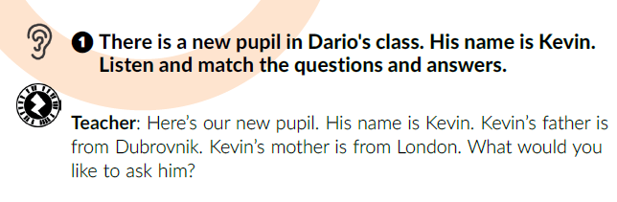

Imagine there is a new pupil in your class. What would you ask him or her?
Who is the new pupil?
Where is he from?
Who else is there in Kevin’s class?

Slide 3
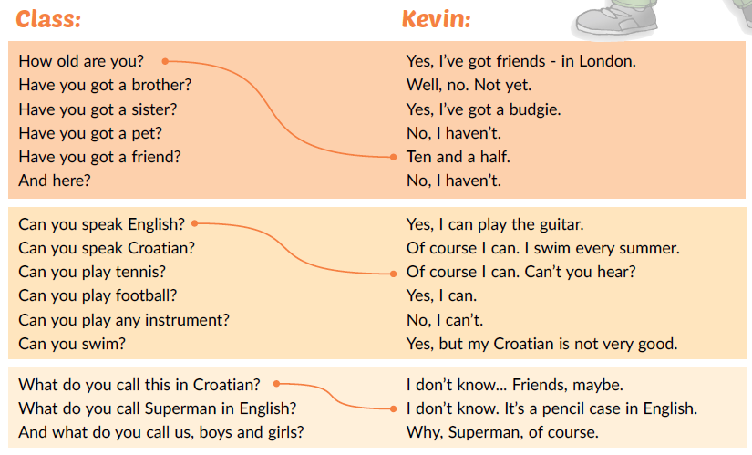
Listen and match.

Slide 4
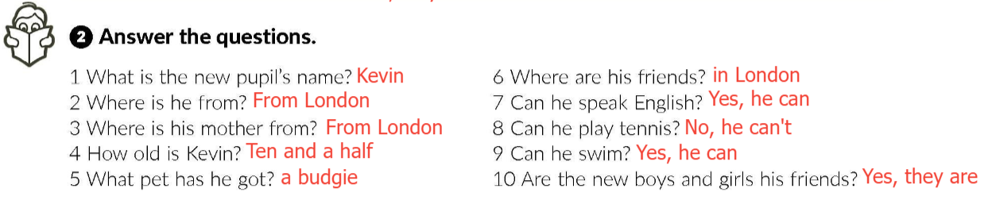
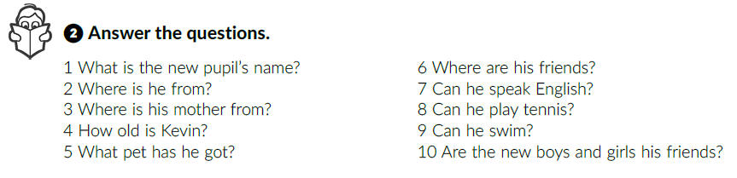
Work in pairs.

Slide 5
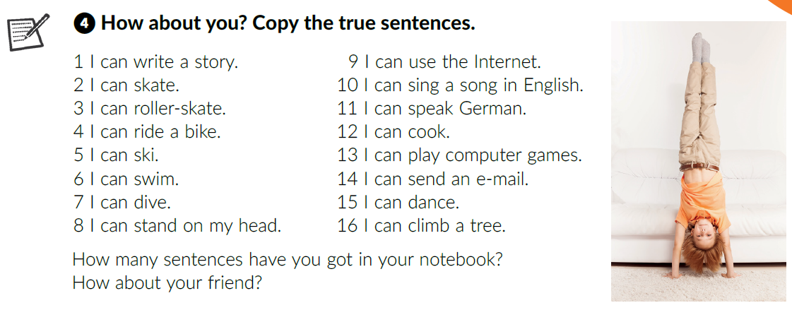
Work in pairs. Read the true sentences about yourself to your friend and then listen to him / her.

Slide 6
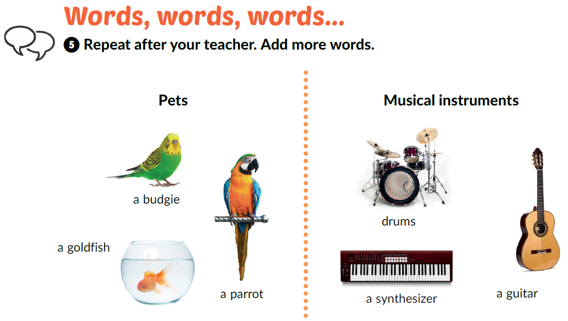
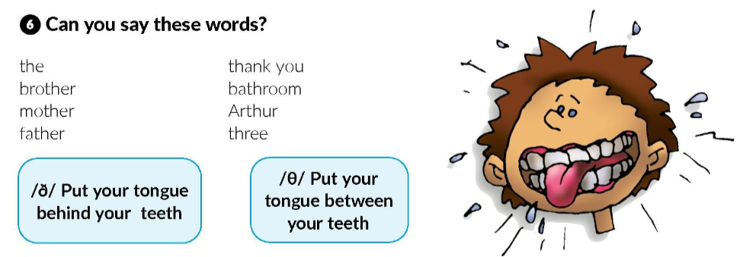

Learn more: Practise the sound. Complete the tasks.
https://www.e-sfera.hr/dodatni-digitalni-sadrzaji/4e4f92ee-ff87-4e56-ac0f-629195ed1259/

Slide 7
Learn more: How to choose a pet. Complete the tasks.
https://www.e-sfera.hr/dodatni-digitalni-sadrzaji/4e4f92ee-ff87-4e56-ac0f-629195ed1259/

Slide 8
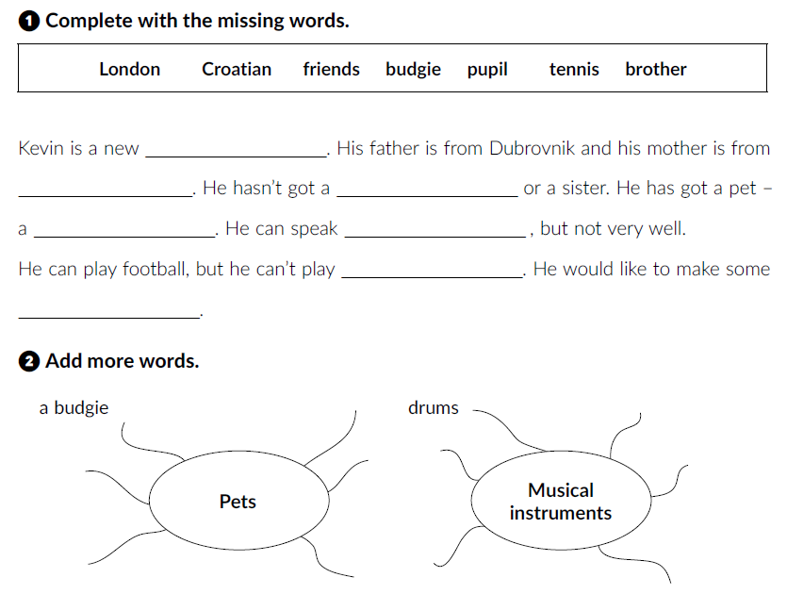
workbook p. 26
pupil
London
brother
budgie
Croatian
tennis
friends

Slide 9
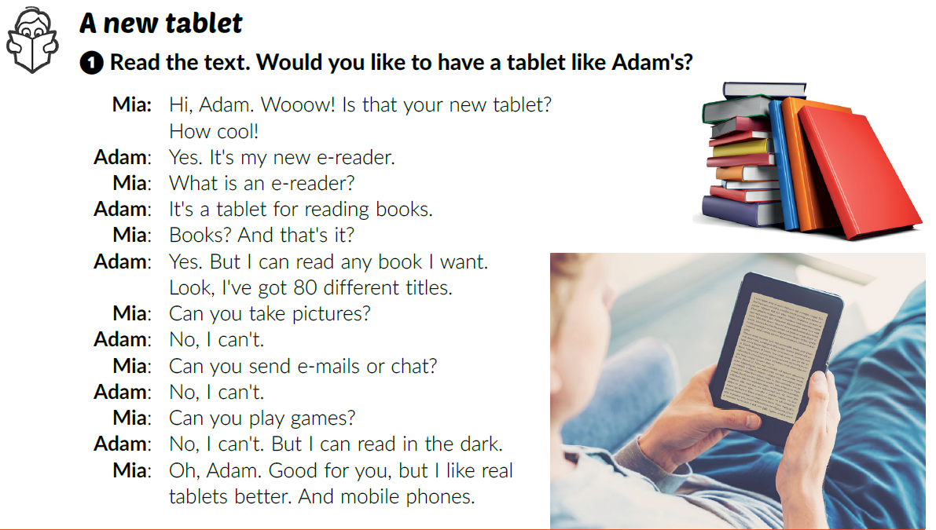
Click on the following link and do the task.
https://wordwall.net/resource/260147/what-can-you-do-what-cant-you-do-discuss-with-your-teacher-or
Have you got a mobile phone?
Have you got a tablet?
How often do you use it / them?
Textbook p. 42
Would you like to have a tablet like Adam’s?

Slide 10
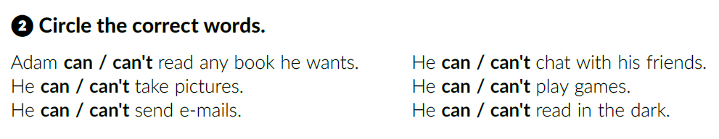
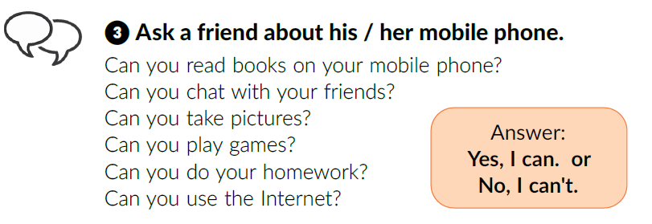
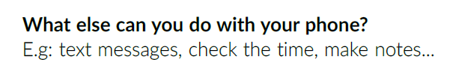
Read the text again and circle the correct answer.
In pairs, read the text out loud.

Slide 11

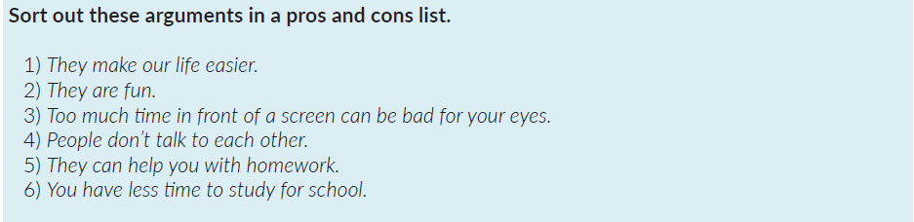
Work in groups.
What are the pros and cons of modern gadgets?
The list below can help you.
Have a class discussion.

Slide 12
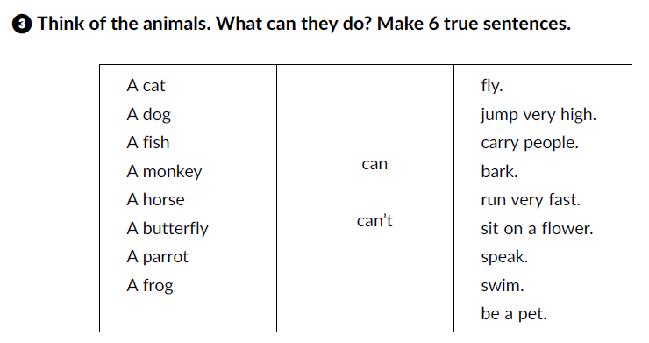
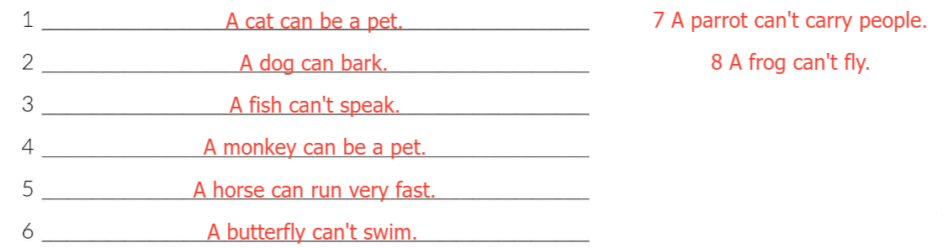
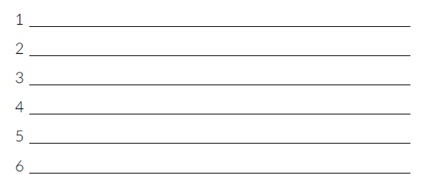
Complete the tasks in your workbook (pages 26, 27 and 28).

Slide 13
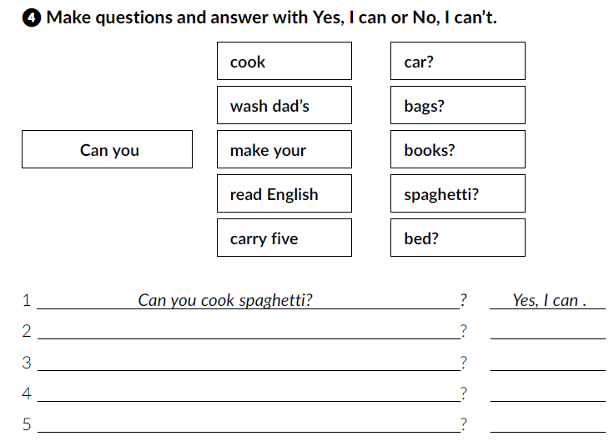
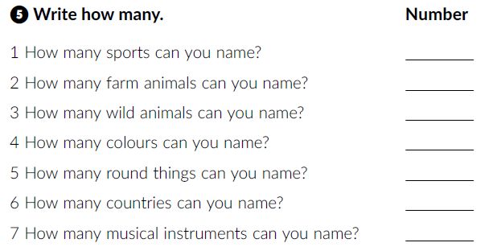
Can you wash your dad’s car
Can you make your bed
Can you read English books
Can you carry five bags

Slide 14
